Slide 1


overall_1_132573879104528179 columns_1_132573879104528179
Microsoft Office Add-ins
Community call
Update the ASP.NET server in Visual Studio and discussion on getting started
Feedback request for Excel Add-in Auto install launch function
October 12, 2022

Slide 2
Agenda
David Chesnut
Yawei Zhu
Senior Dev Writer
Senior Product Manager

Slide 3
Update the ASP.NET server in Visual Studio
David Chesnut: Senior Dev Writer

Slide 4
Discussion on getting started
David Chesnut: Senior Dev Writer

Slide 5
What’s your background?
VSTO COM add-in developer?
Web developer only?

Slide 6
What's your preferred framework?
React, Angular, jQuery, plain JS, other?

Slide 7
what's your preferred IDE for learning Office Add-ins?
Visual Studio
VS Code
Other

Slide 8
Were there gaps in our docs when you were learning how to build Office Add-ins?

Slide 9
Our suggested learning path
Basics (hello world): What are the parts of an Office Add-in?
Entry point = onReady()
Files = xml manifest, html page and js
Dependencies = office.js
Building (quickstart):
yo office with node and npm
VS templates with ASP.NET and Nuget
Add first feature (tutorial): How to add basic UI and interact with the document. Cover context and async pattern.

Slide 10
Yawei Zhu: Senior Product Manager

Slide 11
Investigatation about Add-in auto install/launch function
Excel add-in PM: Yawei Zhu

Slide 12
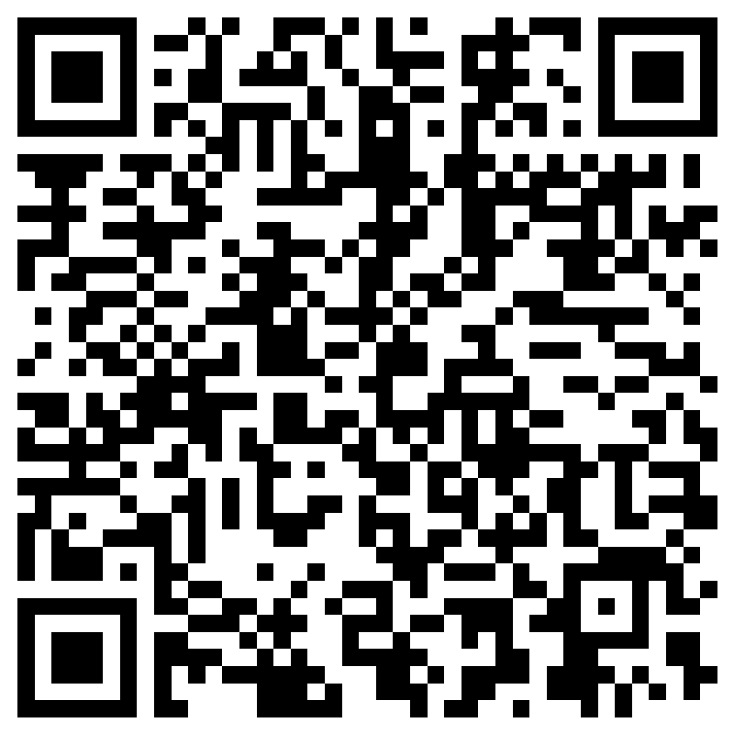
What we investigating
Add-in auto install/auto launch function and related scenario
Good user experience
Under control
Reasonable scenario

Slide 13


Community spotlight
Thank you!
Eric Legault
https://github.com/OfficeDev/PnP-OfficeAddins
https://pnp.github.io/recognitionprogram/

Slide 14
Question:
Hi. Thanks for a good community! I especially enjoyed the April session where Onur Onder made a really good demonstration on some beta PowerPoint APIs and some nice features he developed in ScriptLab. I was just curious if these snippets were shared in a public gist to allow for a closer look. Would be really appreciated if that was the case. If I could make a wish for future content, I'm really curious to get some high-level pointers on how to develop a custom chart object. I'm inspired by ThinkCell (this is not Office.js as far as I understand) and MekkoChart (www.mekkographics.com) that have some nice chart elements and a few steps down the road I would like to make my own charts... Would be really good to go about it in the best way with some guidance from the real experts.
Thanks again!
Answer:
We will be posting these snippets soon.
Q&A

Slide 15
Question:
When will Microsoft Word Forms API's will be added in office JS?
Answer:
It is currently on the roadmap, but we do not have an exact date.
Q&A

Slide 16
Question:
Hi! Is it possible to write Outlook AddIn that will work with gmail account to set email signature in Outlook using event-based activation as described in https://learn.microsoft.com/en-us/samples/officedev/pnp-officeaddins/outlook-add-in-set-signature/ ?
Answer:
We will answer this question on the blog post from this call.
Q&A

Slide 17






New to Office Add-ins?
 | Documentation | https://aka.ms/office-add-ins-docs
 | Quick starts | Outlook, Excel, Word, PowerPoint
 | Script Lab | https://aka.ms/getscriptlab
 | Samples | https://aka.ms/officeaddinsamples
 | Microsoft 365 Developer Program | https://aka.ms/M365devprogram
 | Office Scripts | aka.ms/office-scripts-docs
Notes:
m365-dev-sig

Slide 18
Engage with the team
Engagement | Where to go
Technical questions about Office Add-ins | https://aka.ms/office-addins-dev-questions [office-js-dev] [office-addins-dev] https://stackoverflow.com [office-js] [outlook-web-addins] [office-scripts]
Product bugs | https://github.com/OfficeDev/office-js
Feature requests and ideas | https://aka.ms/m365dev-suggestions
Send a Smile or Frown | Inside Office
Notes:
m365-dev-sig

Slide 19
Microsoft 365 developer community calls
Microsoft 365 platform call (weekly) https://aka.ms/m365-dev-call
Microsoft 365 & Power Platform Development (bi-weekly) https://aka.ms/m365-dev-sig
Viva Connections &
SharePoint Framework (bi-weekly) https://aka.ms/spdev-spfx-call
Adaptive Cards (monthly) https://aka.ms/adaptivecardscommunitycall
Microsoft identity platform (monthly) https://aka.ms/IDDevCommunityCalendar
Office Add-ins (monthly) https://aka.ms/officeaddinscommunitycall
Power Platform (monthly) https://aka.ms/PowerPlatformMonthlyCall
All calls and assets: https://aka.ms/m365pnp
Notes:
m365-dev-sig

Slide 20
Thank you
Recording will be available in 24 hours on
Microsoft 365 Community (PnP) YouTube channel
https://aka.ms/M365PnP/videos
(subscribe today)
Follow us on Twitter
@Microsoft365Dev | @M365PnP
Next call: November 9th at 8:00 AM Pacific Time
https://aka.ms/officeaddinscommunitycall
Agenda: https://aka.ms/officeaddinsagenda
Submit your questions: https://aka.ms/officeaddinsform

